Slide 1
Strength and Conditioning – Injury Prevention
Louis Howe
RHUL Strength and Conditioning Coach

Slide 2
Introduction
What to do if you get injured.
Understand why we get injured.
How to prevent most injuries from happening.

Slide 3
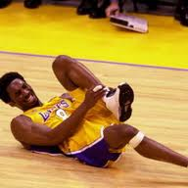
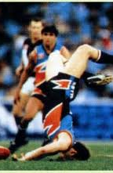
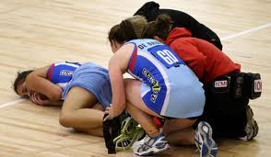
Why do we get injured?

Slide 4
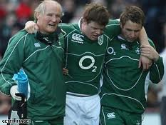
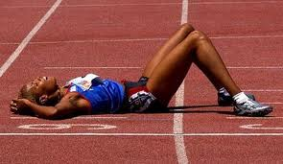
Why do we get injured?
Too much load.
OR
Poor overall conditioning.
OR
Bad luck!

Slide 5
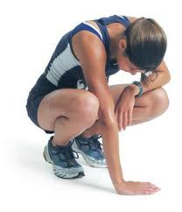
Load: “the cumulative amount of stress placed on an individual from a single workout or over a period of time.”

Slide 6
What is training load?

Slide 7
How do we control load

Slide 8
How do we control load?
Manage weekly training load.
Progress loading gradually.
Raise our optimal zone.

Slide 9
Managing weekly training load…
We must manage training stress:
Daily
Weekly
Monthly

Slide 10
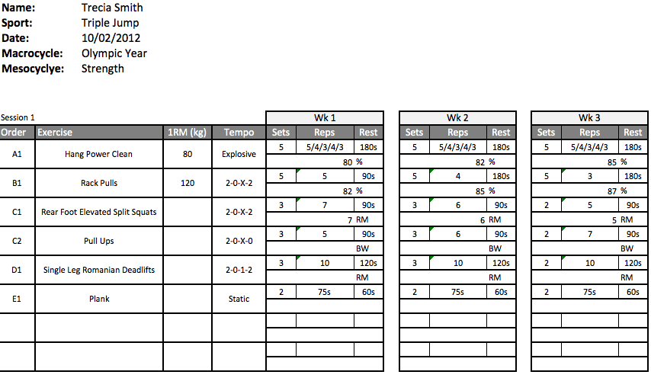
Managing weekly training load….. Plan!

Slide 11
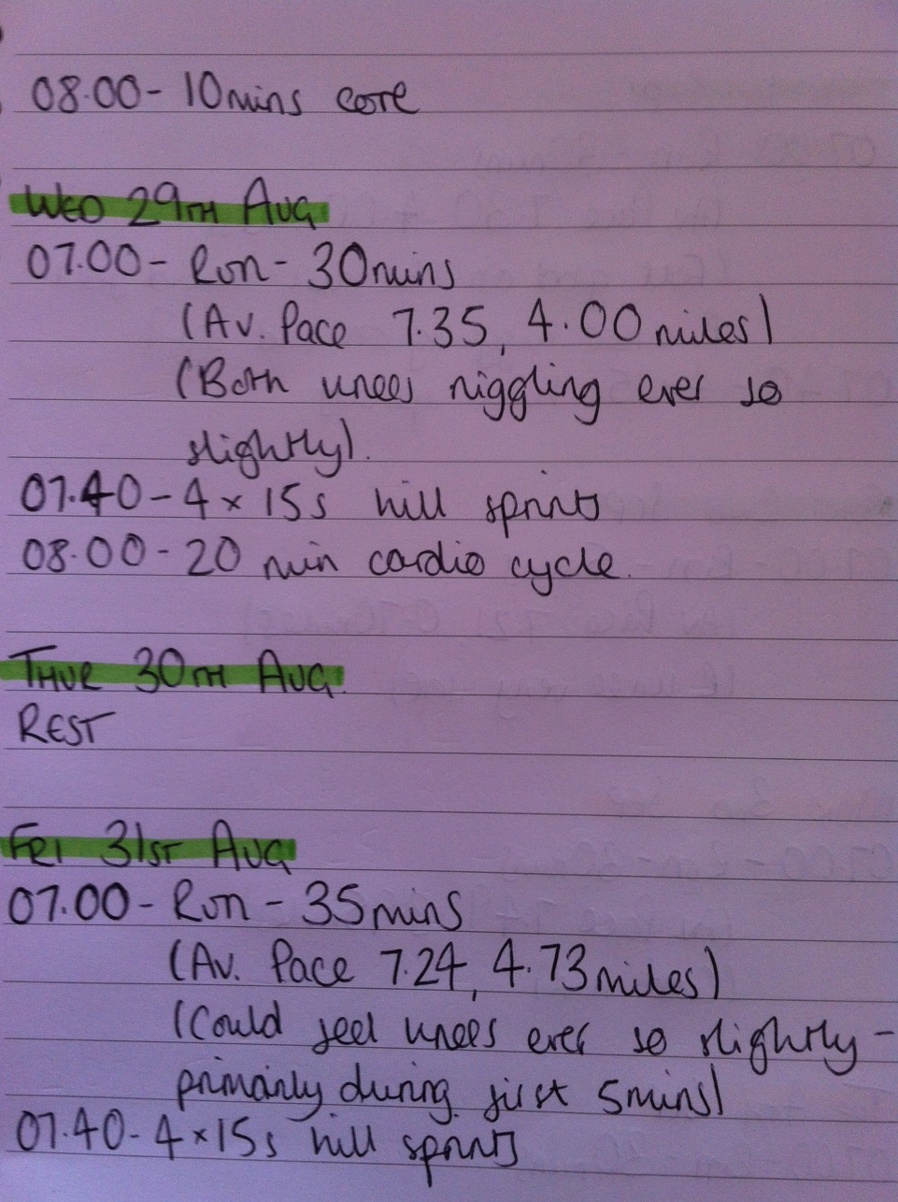
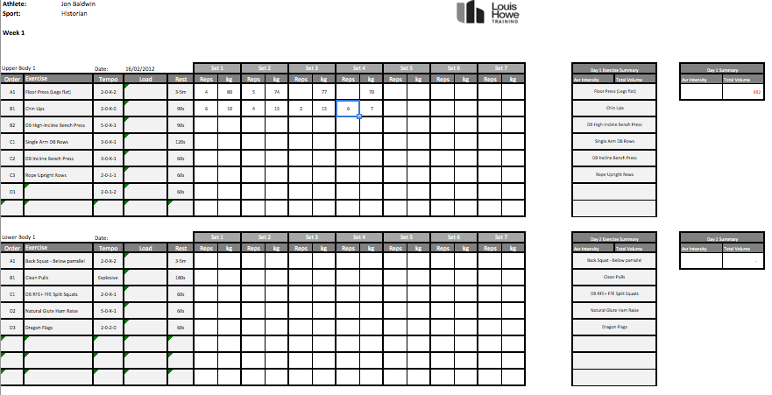
Managing weekly training load….. Keep records!

Slide 12
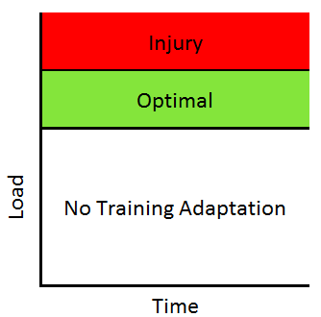
Progress loading slowly…..
A
B

Slide 13
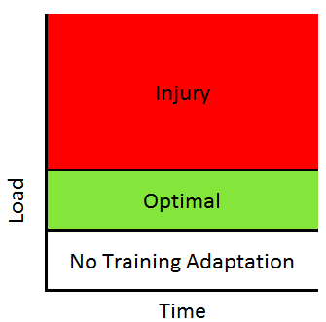
Raising our optimal zone….

Slide 14
Raising the Optimal Zone….
Raising the Optimal Zone
Lowering the Optimal Zone
Lifestyle
Good sleep
Optimal nutrition and lifestyle
Manage stress
Training
High conditioning levels
Thorough warm up
TRAIN ALL YEAR ROUND
Lifestyle
Lack of sleep quantity / quality
Alcohol consumption
Poor nutrition and lifestyle
Manage stress
Training
Skip conditioning sessions
Poor / No warm ups
Poor injury management
INCONSISTENT TRAINING

Slide 15
Solution

Slide 16
BALANCE RECOVERY AND TRAINING ALL YEAR MANAGE LOAD – PLAN AND KEEP A TRAINING LOG PROGRESS SLOWLY

Slide 17
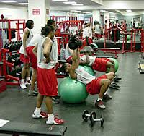
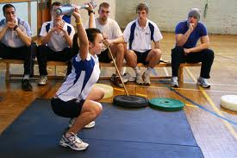
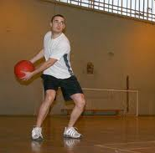
Preventing injuries with Strength and Conditioning

Slide 18
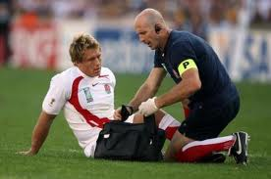
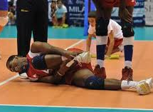
Injuries in Sport
Every athlete gets injured (Hawkins et al., 2001).
Games = Injuries (Morgan & Oberlander, 2001).
Fatigue = Injuries (Gabbett et al., 2004).

Slide 19
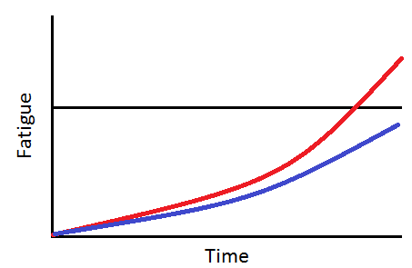
Games + Fatigue = Injured!
Unconditioned
FITNESS LIMIT
Conditioning

Slide 20
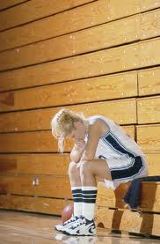
Why is S&C so important? Injury
Injuries can be reduced with:
Weights (Askling et al., 2003).
Plyometrics (Heidt et al., 2000).
Sprint training (Heidt et al., 2000).
Balance training (Emery et al., 2007).
Core stability (Holmich et al., 2009).
Progressive warm up (Gilchrist et al., 2008).

Slide 21
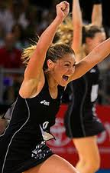
Why is S&C so important? - Performance
Team | League Position | VO² Max
Ujpesti Dozsa | 1st | 66.6
FTC | 2nd | 64.3
Vasas SC | 3rd | 63.3
Honved SE | 4th | 58.1
(Apor, 1988)
Notes:
Many of the activities such as sprinting, jumping and changing direction can potentially be fundamental for a winning outcome (Wragg, Maxwell, & Doust, 2000).
Anaerobic qualities such as jump heights, acceleration times and maximal strength levels in both the lower and upper extremities have been shown to discriminate team’s positional status in a professional football league (Wissløff, Helgerud, & Hoff, 1998).

Slide 22
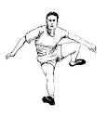
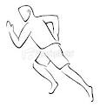
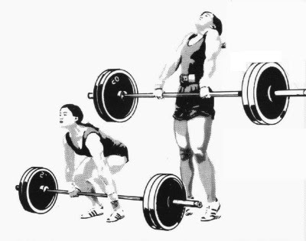
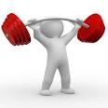
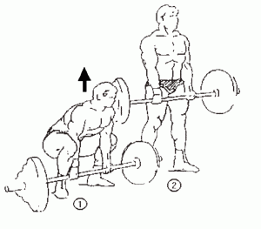
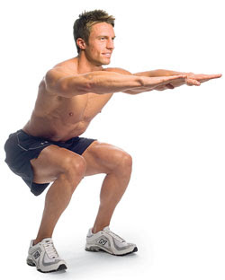
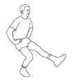
Overall Conditioning
5.
4.
3.
2.
1.

Slide 23
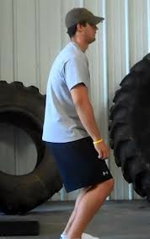
Movement Skills
Vs.

Slide 24
Solution

Slide 25
GO TO CONDITIONING SESSIONS

Slide 26
Physical Conditioning
5.
4.
3.
2.
1.

Slide 27
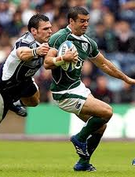
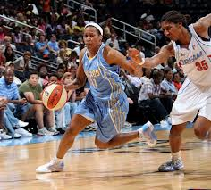
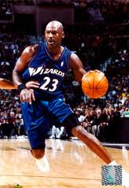
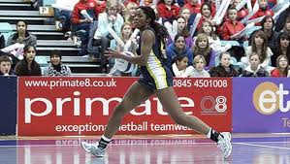
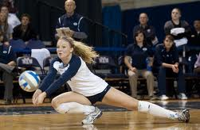
Stability / Mobility
Notes:
Physical qualities = coordination, power, strength, speed, balance, etc.

Slide 28
Stability / Mobility
Vs.
Notes:
Physical qualities = coordination, power, strength, speed, balance, etc.

Slide 29
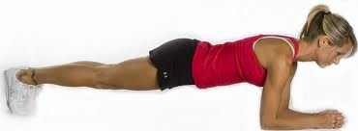
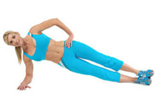
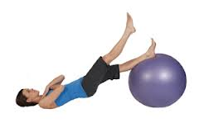
Stability - Muscle Endurance
Plank
Rating | Score
Poor | <120s
Satisfactory | 120-180s
Good | >180s
Side Bridge
Rating | Score
Poor | <60s
Satisfactory | 60-120s
Good | >120s
Double Leg Lower
Rating | Score
Poor | <10
Satisfactory | 10-40
Good | >40
Single leg hamstring bridge
Rating | Score
Poor | <20
Satisfactory | 20-40s
Good | >40
Notes:
Physical qualities = coordination, power, strength, speed, balance, etc.

Slide 30
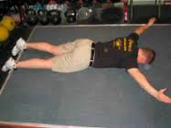
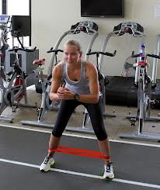
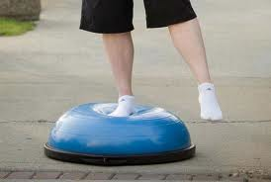
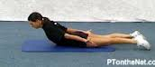
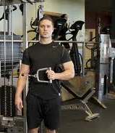
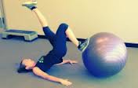
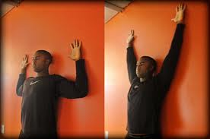
Stability – Other Examples
Notes:
Physical qualities = coordination, power, strength, speed, balance, etc.

Slide 31
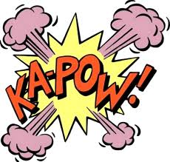
Body Composition
Contact Sports
Mass = Injury Prevention
70kg vs. 95kg

Slide 32
Energy System Development
30 days to get “fit”?
Steady state vs. Interval Training.
Must be specific to what we are trying to achieve.
Notes:
4,828m vs. 430m = 25 minutes
Both increase aerobic qualities.
Only one increases anaerobic qualities.
Only one has a significant effect on body fat.
Interference affect
Can be useful

Slide 33
Solution

Slide 34
GO TO CONDITIONING SESSIONS

Slide 35
Physical Conditioning
5.
4.
3.
2.
1.

Slide 36
Strength
Vs.

Slide 37
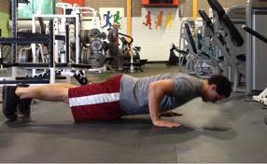
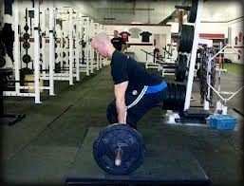
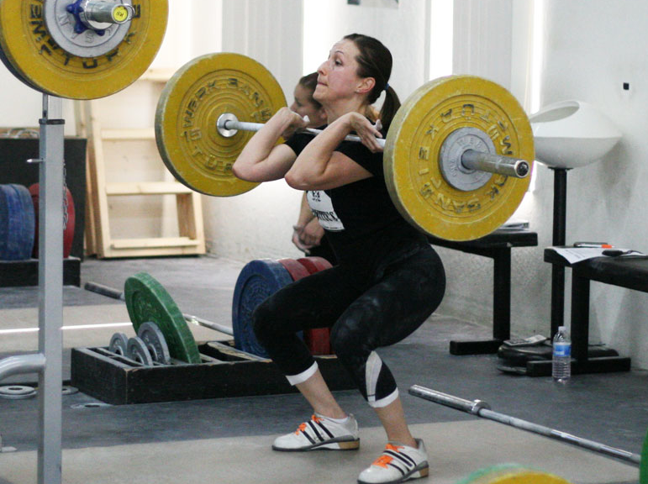
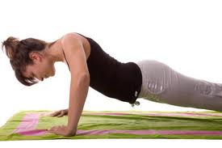
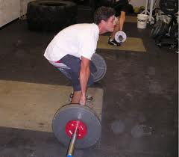
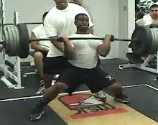
Strength - Technique
Vs.
Vs.
Vs.

Slide 38
Strength

Slide 39
Solution

Slide 40
GO TO YOUR WEIGHTS SESSION THIS SATURDAY!

Slide 41
Physical Conditioning
5.
4.
3.
2.
Nutrition and lifestyle
1.

Slide 42
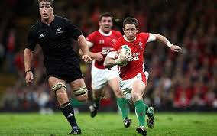
Power & Speed
Can you be strong and slow?
Can you be weak and fast?
Must be specific to what we want to achieve.

Slide 43
Solution

Slide 44
GO TO CONDITIONING SESSIONS

Slide 45
Conclusion
We must control the various contributors to training load.
Prevent injuries with well rounded conditioning.
You must take responsibility for your conditioning.

Slide 46
Questions

