Slide 1


ROYAL HOLLOWAY LINK
INFORMATION, ADVICE AND GUIDANCE FOR YEAR 13S

Slide 2

What is Link?
Our lead programme for Year 13s, Link provides students with information, advice and guidance about university. There are four sessions covering a range of topics including personal statements, study skills and what to expect in your first year at university.
You will:
Meet students from other schools
Spend time with student ambassadors
Take part in sessions to help with your transition to university
Gain experience to include in your personal statement and on your CV

Slide 3
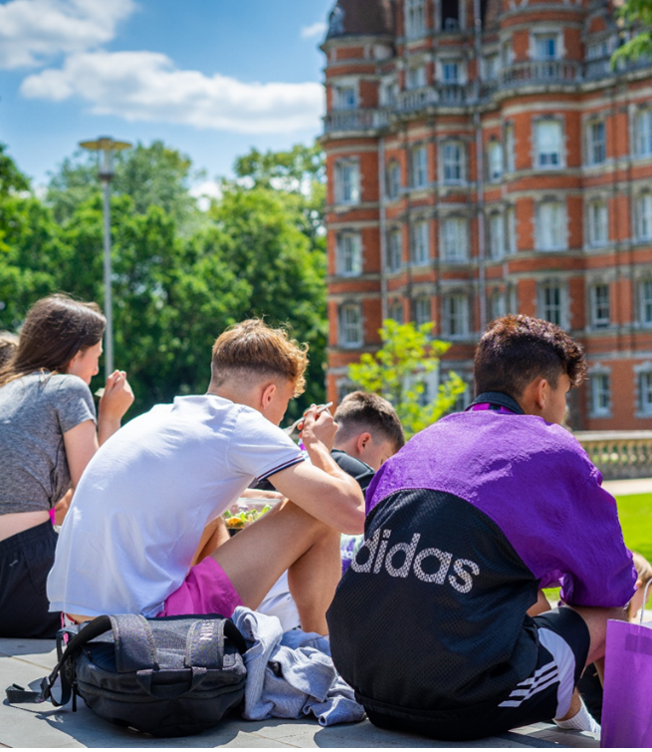
Who is eligible?
Year 13 students from Widening Access backgrounds.
Participants must also:
Study A Levels or equivalent, predicted no lower than CCC (or equivalent)
Have 5 GCSEs grades 9 - 4
Be a UK resident and currently study or have previously studied at a UK school/college

Slide 4
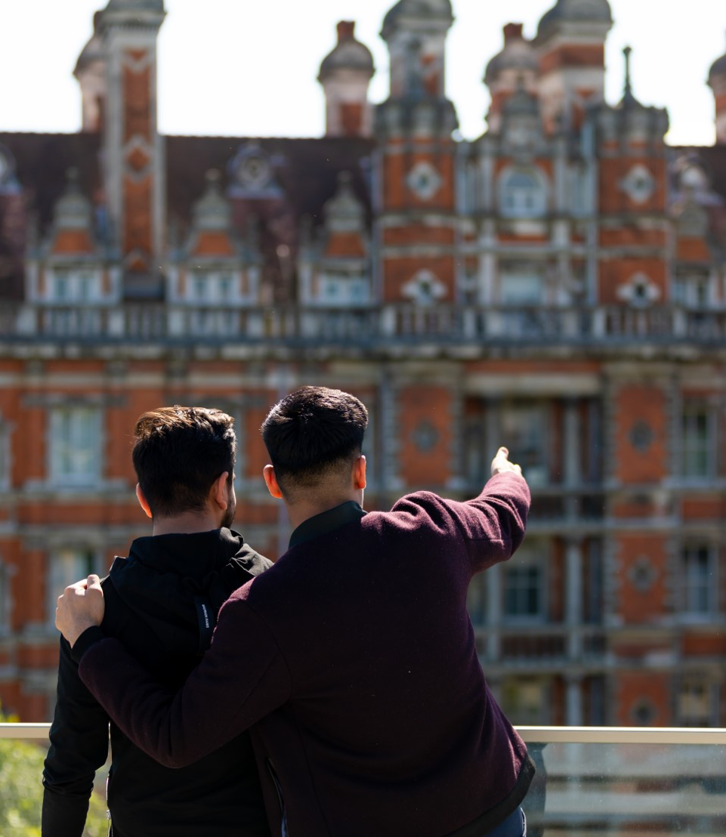
Where is it?
The programme is in person and online.
Most sessions will be on campus here at Royal Holloway, giving you the chance to meet friends and Student Ambassadors in person.
One session will be online, in the evening minimising any disruption to your studies.

Slide 5

When?
There are four sessions taking place across the academic year.
Session timeline:
Session One – Saturday 31 October 2026, 10am
  On campus – UCAS personal statements and Mental Health & Wellbeing
Session Two – Monday 9 November 2026, 5pm
  Online – Financial Support
Session Three – Saturday 23 January 2027, 10am
  On campus – Somewhere to live and Study & Academic Skills
Session Four – Saturday 20 February 2027, 10am
  On campus – Preparing for university and Graduation event

Slide 6

Applying
Applications for 2026/27 are now open!
To apply on our website, go to: Royal Holloway Link
The deadline for applications is midnight on Sunday 18 October 2026.
If we receive a high number of applications before the application closing date, we may close applications early so apply as soon as possible!

Slide 7
Applying
Top tips
Be honest, double check the information is correct – especially the contact information.
Look at the timeline of sessions and make sure you can attend all sessions.
Allow enough time to complete the form in one sitting. You will need a parent/carer to submit permission at the end.
Don’t leave it too late – applications may close early if we receive lots of interest.
Email wa@rhul.ac.uk if you have any questions.

Slide 8

See you on Saturday 31 October 2026!

