Slide 1
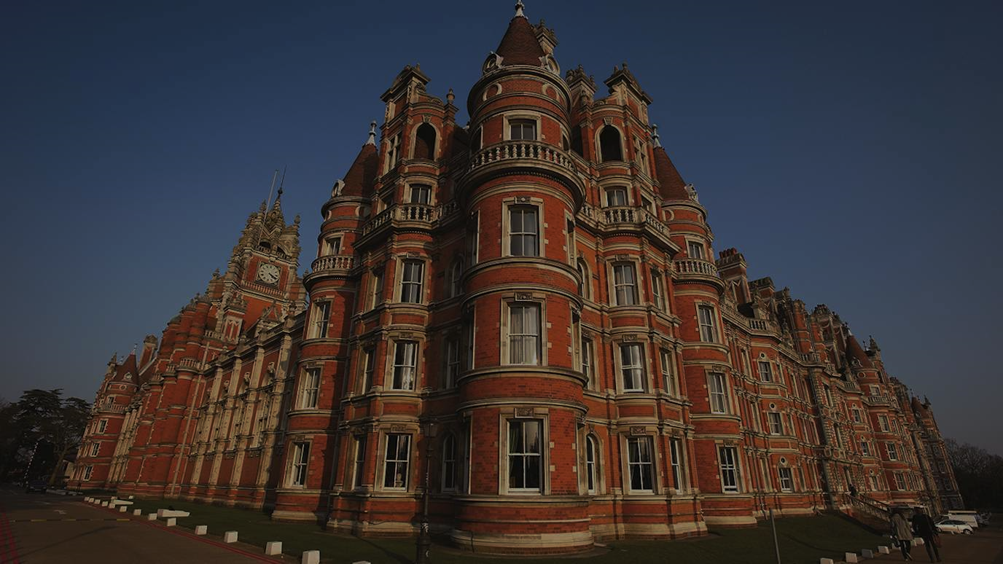

Summer University Residential
Tuesday 30th June – Wednesday 1st July
Royal Holloway Widening Access Team

Slide 2
What?
Who?
Why?
Where?
When?
Summer University Residential 2026

Slide 3

WHAT?
2 days, 1 overnight stay in university accommodation!
Subject taster sessions
Meet current university students
A variety of social and leisure activities
Authentic university taster experience
Completely free
Notes:
2 days and 1 overnight stay on campus
Subject tasters related to the stand you are enrolled on. Experience learning like a real university student
Meet current undergrads – working with students from the minute they arrive (great opportunity for students to ask any questions they might have about the real RHUL experience)
In the evening & throughout the days, students will take part in a variety of social activities (so great opportunity to socialise with likeminded people)
Completely free – including your accommodation, food & all activities
We will have some extra funds available to apply for to cover your transport to and from the university, but cannot guarantee this.

Slide 4
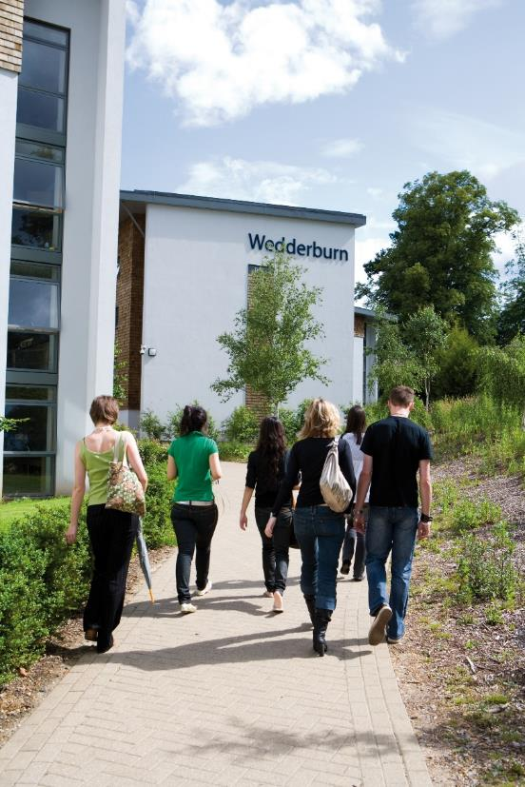
WHERE?
On campus event at Royal Holloway University in Egham
Variety of buildings and facilities
Stay in real university halls accommodation
Notes:
All in the buildings on our campus. See a range of facilities from labs to lecture theatres.
Mix of old & new – spend time in the glorious founders building (the orange building which dates to the 19th century), but also spend time in in our state of the art shilling building which is made for Electronic Engineering
Stay in typical university halls of residence. You will have your own room with an ensuite and will share a flat with other students attending and staff working.

Slide 5
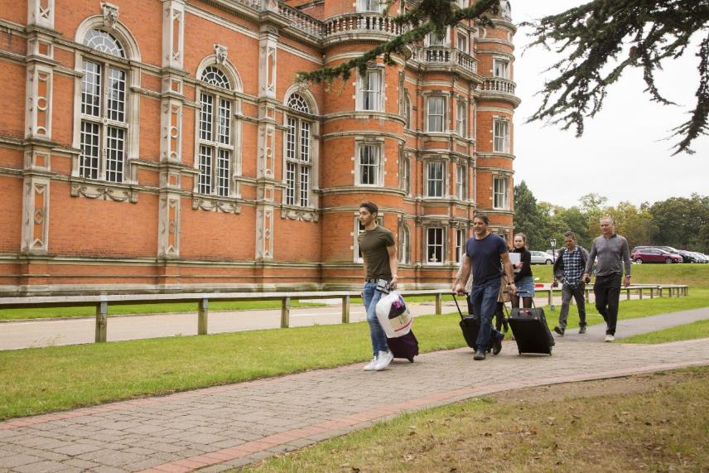
WHEN?
Applications close on 22 March 11:59pm
Application Timeline
Applications open on 3 February
Applications close on 22 March
You will hear from us by 16 April
You need to confirm your place by 23 April. If you do not confirm your place, we will withdraw it.
If we receive a high number of applications, we may close applications early so apply as soon as possible!

Slide 6
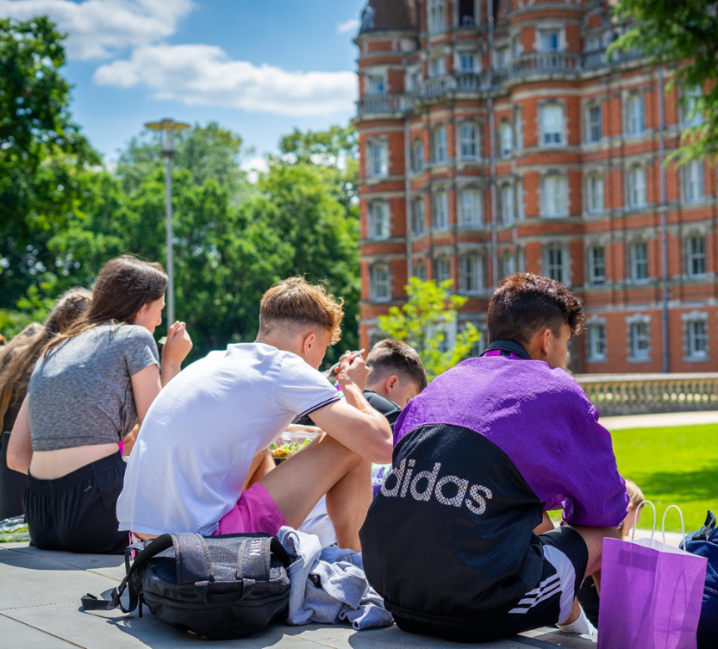
WHO?
Open to year 12 students from Widening Access Backgrounds
Meet students from other schools
Spend time with student ambassadors
Learn from lecturers and university staff
Notes:
Please encourage students to check the full eligibility criteria on the website
Open to year 12 students
Students will meet Royal Holloway student ambassadors – work with them in the day, get to socialise with them & ask any questions
Students will have taster sessions from our expert academic lecturers
Information, advice and guidance sessions from the Widening Access team, covering how to apply, student life etc.

Slide 7


How to apply
Please check the full eligibility criteria and additional information on the website
Application form top tips
Be honest
Double check the information is correct – especially the contact information
Make sure you allow enough time to complete the form in one sitting- you will need a parent/carer to submit permission at the end.
Tell your parents/carers and teachers about your application – you will need permission from both your school and parents/carers to attend the residential.
Don’t leave it too late – we may close early if we receive lots of applications
Email wa@rhul.ac.uk if you have any questions
royalholloway.ac.uk/summer-uni
Or you can just type in “Royal Holloway residentials”

Slide 8



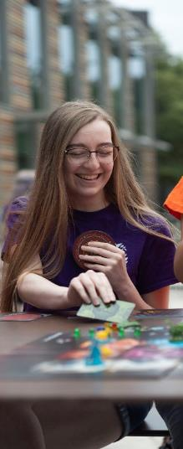
WHY?
Explore a subject you’re interested in
Authentic university taster experience
Excellent experience to include on personal statements and CV’s
Meet new people
New experiences

Slide 9

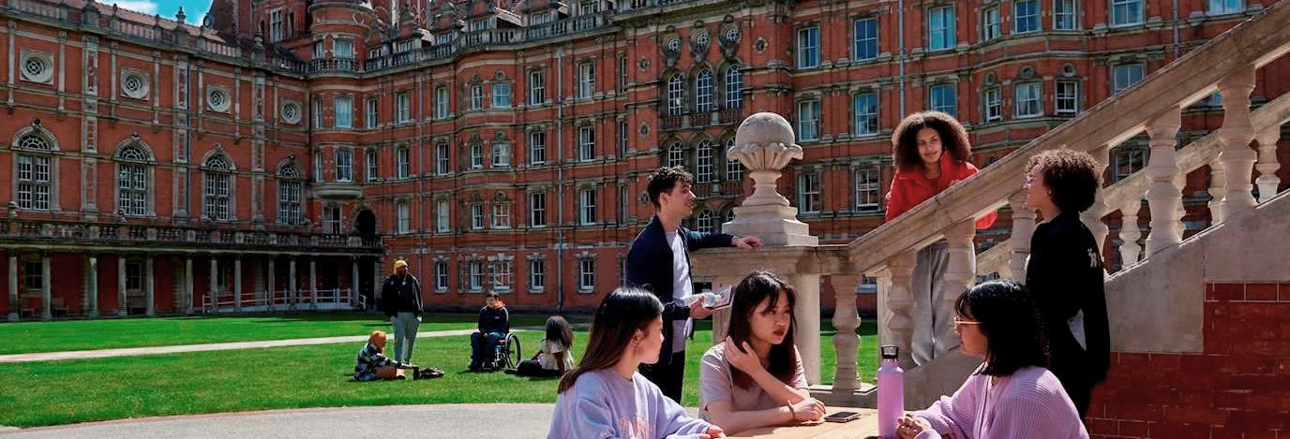


@royal_holloway
@royalholloway
@RoyalHollowayUoL
Summer University:
30th June – 1st July
Scan QR Code for more information
Notes:
We encourage students to scan the QR code for more information. Please also feel free to send any questions to wa@rhul.ac.uk

