Slide 1



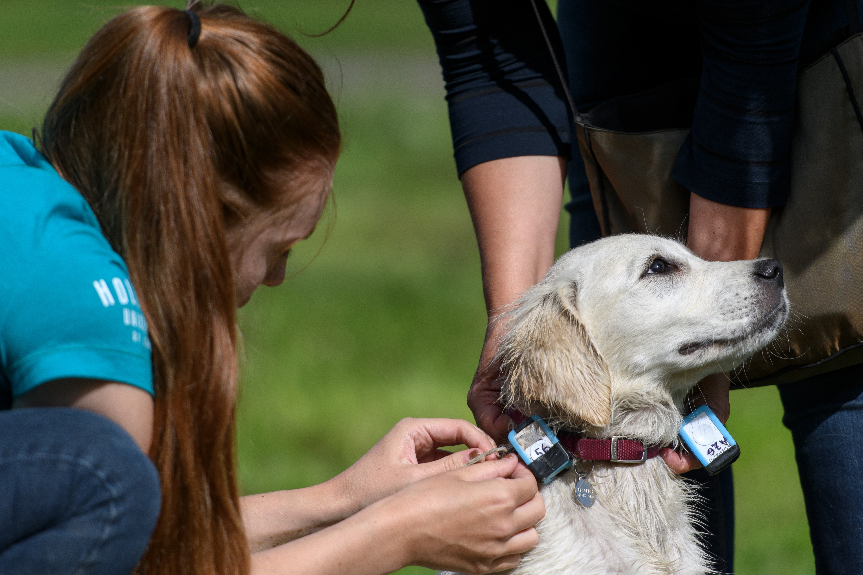
Paws on paths: the impact of dog walking on ground nesting birds
Dr Sarah Papworth and Dr Becky Thomas

Slide 2




CONTENTS
01 | Background research
02 | Project summary
03 | Timeline
04 | Key activities / events
05 | Outputs
06 | Impact
07 | Next steps
FOR WHAT MATTERS

Slide 3




Previous research quantified the disturbance caused by dog walking on lowland heaths
Biodiversity crisis
Many species in decline and habitats degraded
In the UK, lowland heath habitats and the species found there are under threat
1
High densities of dog in the UK
High levels of disturbance caused on lowland heaths in the UK due to dog walking
Dogs off lead cause disturbance to breeding birds
2
GPS tracking study
Our research quantified dog walking behaviour in lowland heaths in Southern England
Dog walking resulted in up to a 21% increase in reserve area disturbed
3
Can we keep paws on paths?
Dogs on the path reduce the area of disturbance
Engagement with owners using signage to change behaviours
4

Slide 4
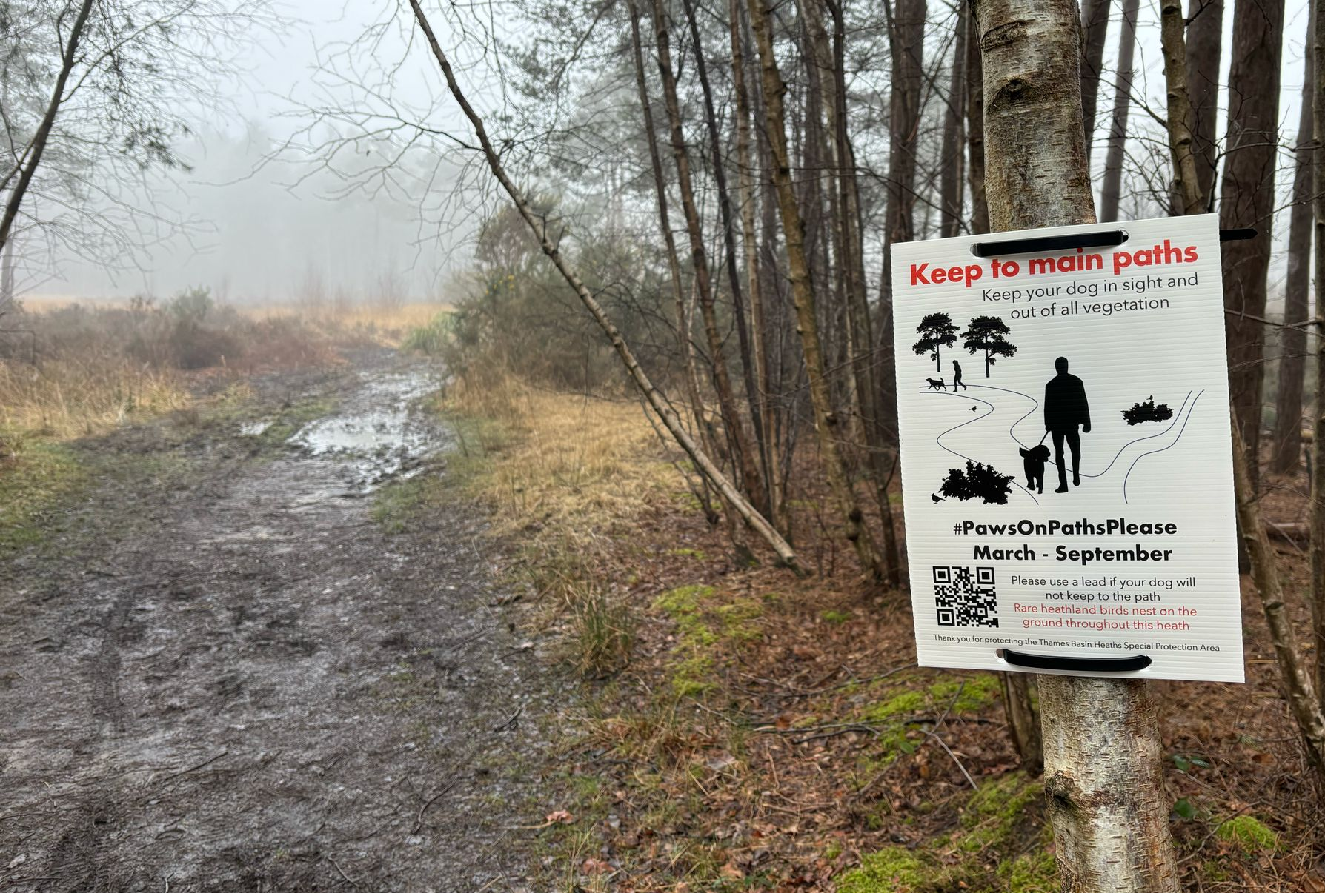

Resources were developed for land managers to reduce the impact of dogs
Project Team
RHUL
Dr Sarah Papworth and Dr Becky Thomas
Partner(s)
Surrey Wildlife Trust and Thames Basin Heaths Partnership
Objectives
1. To share best practice about behaviour change interventions
2. Supporting our partners to monitor the impacts of signage produced on the behaviour of dog walkers
Key Outputs & Impact
Practitioner focused briefing on dog walking behaviour and behaviour change interventions
Effective signage about dog-walking behaviour (as tested in this project)
Webpage informing dog walkers about the impact of dogs
Report detailing the monitoring impacts of these activities
What’s next?
We would like to run a national webinar to share more widely what we learnt about effective signage with other landowners/managers

Slide 5
The project spanned 7 months, between December 2024 and June 2025
Effectiveness evaluated
Project partners learnt about monitoring findings
Project partners requested additional monitoring of sign impact
Report on previous research
Production of report on previous research
December 2024
February 2025
June 2025
January 2025
March 2025
Project start
Began meeting with partners
Sign design began
Signs on sites
Sign design finalised
Signs erected on 8 heathlands
Monitoring of signage began
Project end
First round monitoring report produced
Webpage content produced, pending partner approval
Monitoring of sign impact in progress

Slide 6
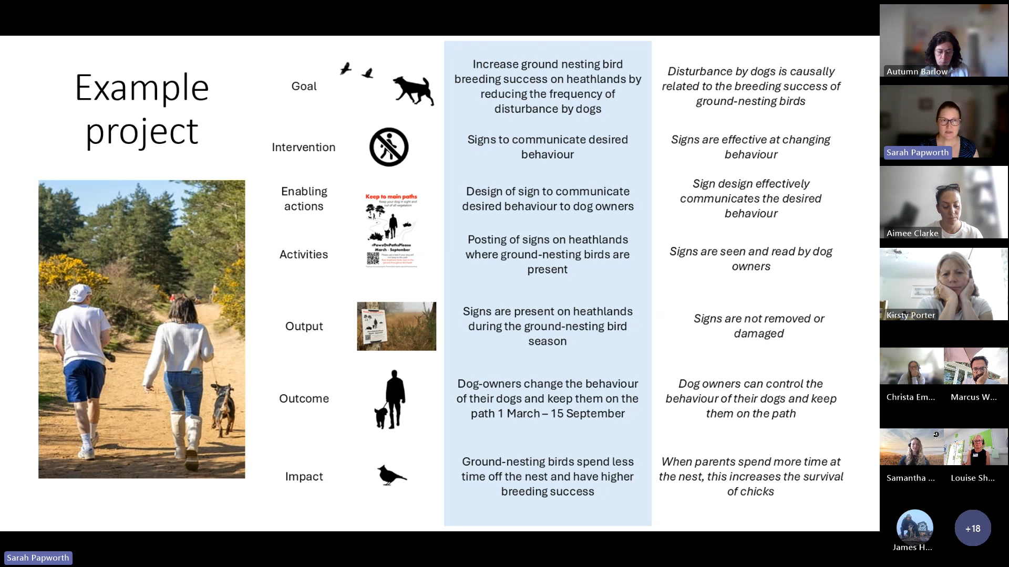
Key activities included participation in various talks and workshops
  Project development meetings with collaborators (seven)
  Presentation to national Wildlife Trust staff about the project
  Participation in the Heathland code and recreation management workshop
  Participation in the behaviour change for conservation workshop.
  Presentation of monitoring results to project partners
  Presentation to Curlew Action
Dr Sarah Papworth presenting to Wildlife Trust staff

Slide 7
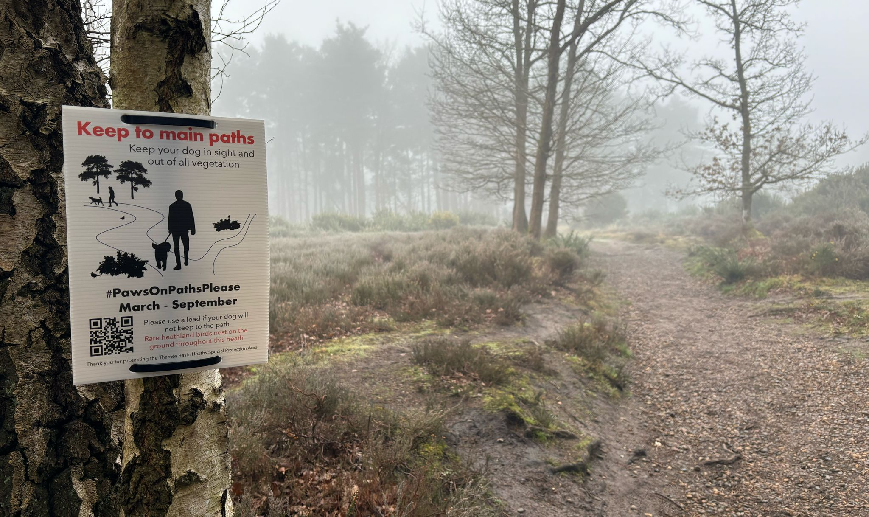
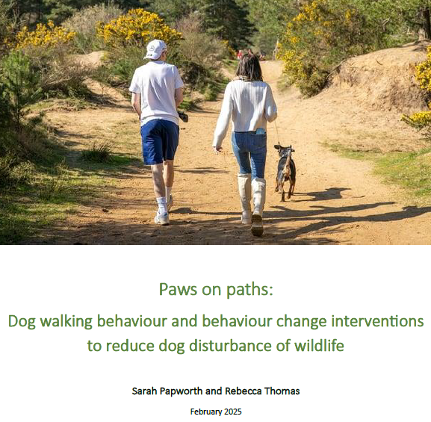
Key outputs included a report and development of on-site signage
Report
  Report on dog walking behaviour and behaviour change interventions available online here.
Signs and materials
  Behaviour change informed signs designed
  Monitoring guidelines produced to assess the efficacy of signs
  Updated website text created
  All materials produced will be shared with the Thames Basin Heath Partnership and Surrey Wildlife Trust

Slide 8
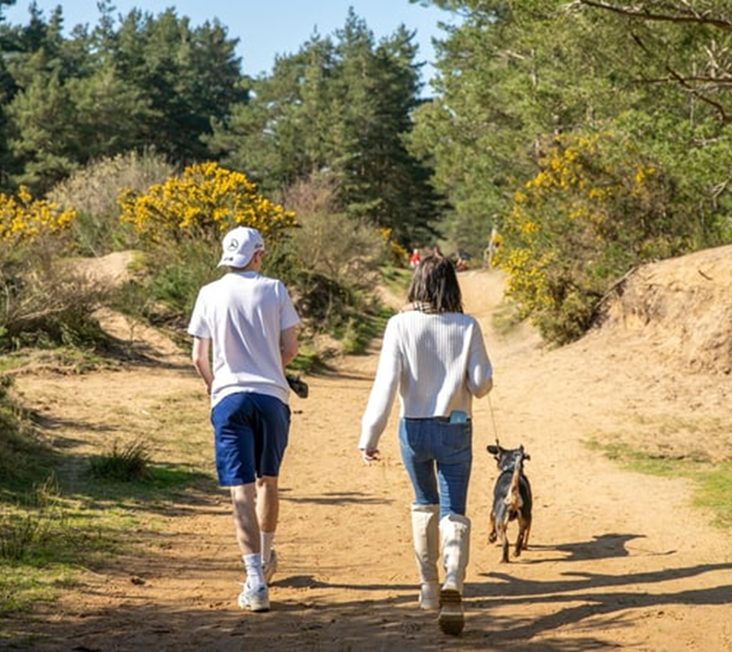
This project collated knowledge of dog impacts and resulted in new signage on lowland heaths
Our report, talks and meetings increased practitioner knowledge of existing research.
Our co-designed sign increased dog walker engagement with the Thames Basin Heaths ‘How can I help?’ webpage.
Our monitoring guidance supported capacity building in evaluation of communications and signage within Surrey Wildlife Trust and the Thames Basin Heaths partnership.

Slide 9
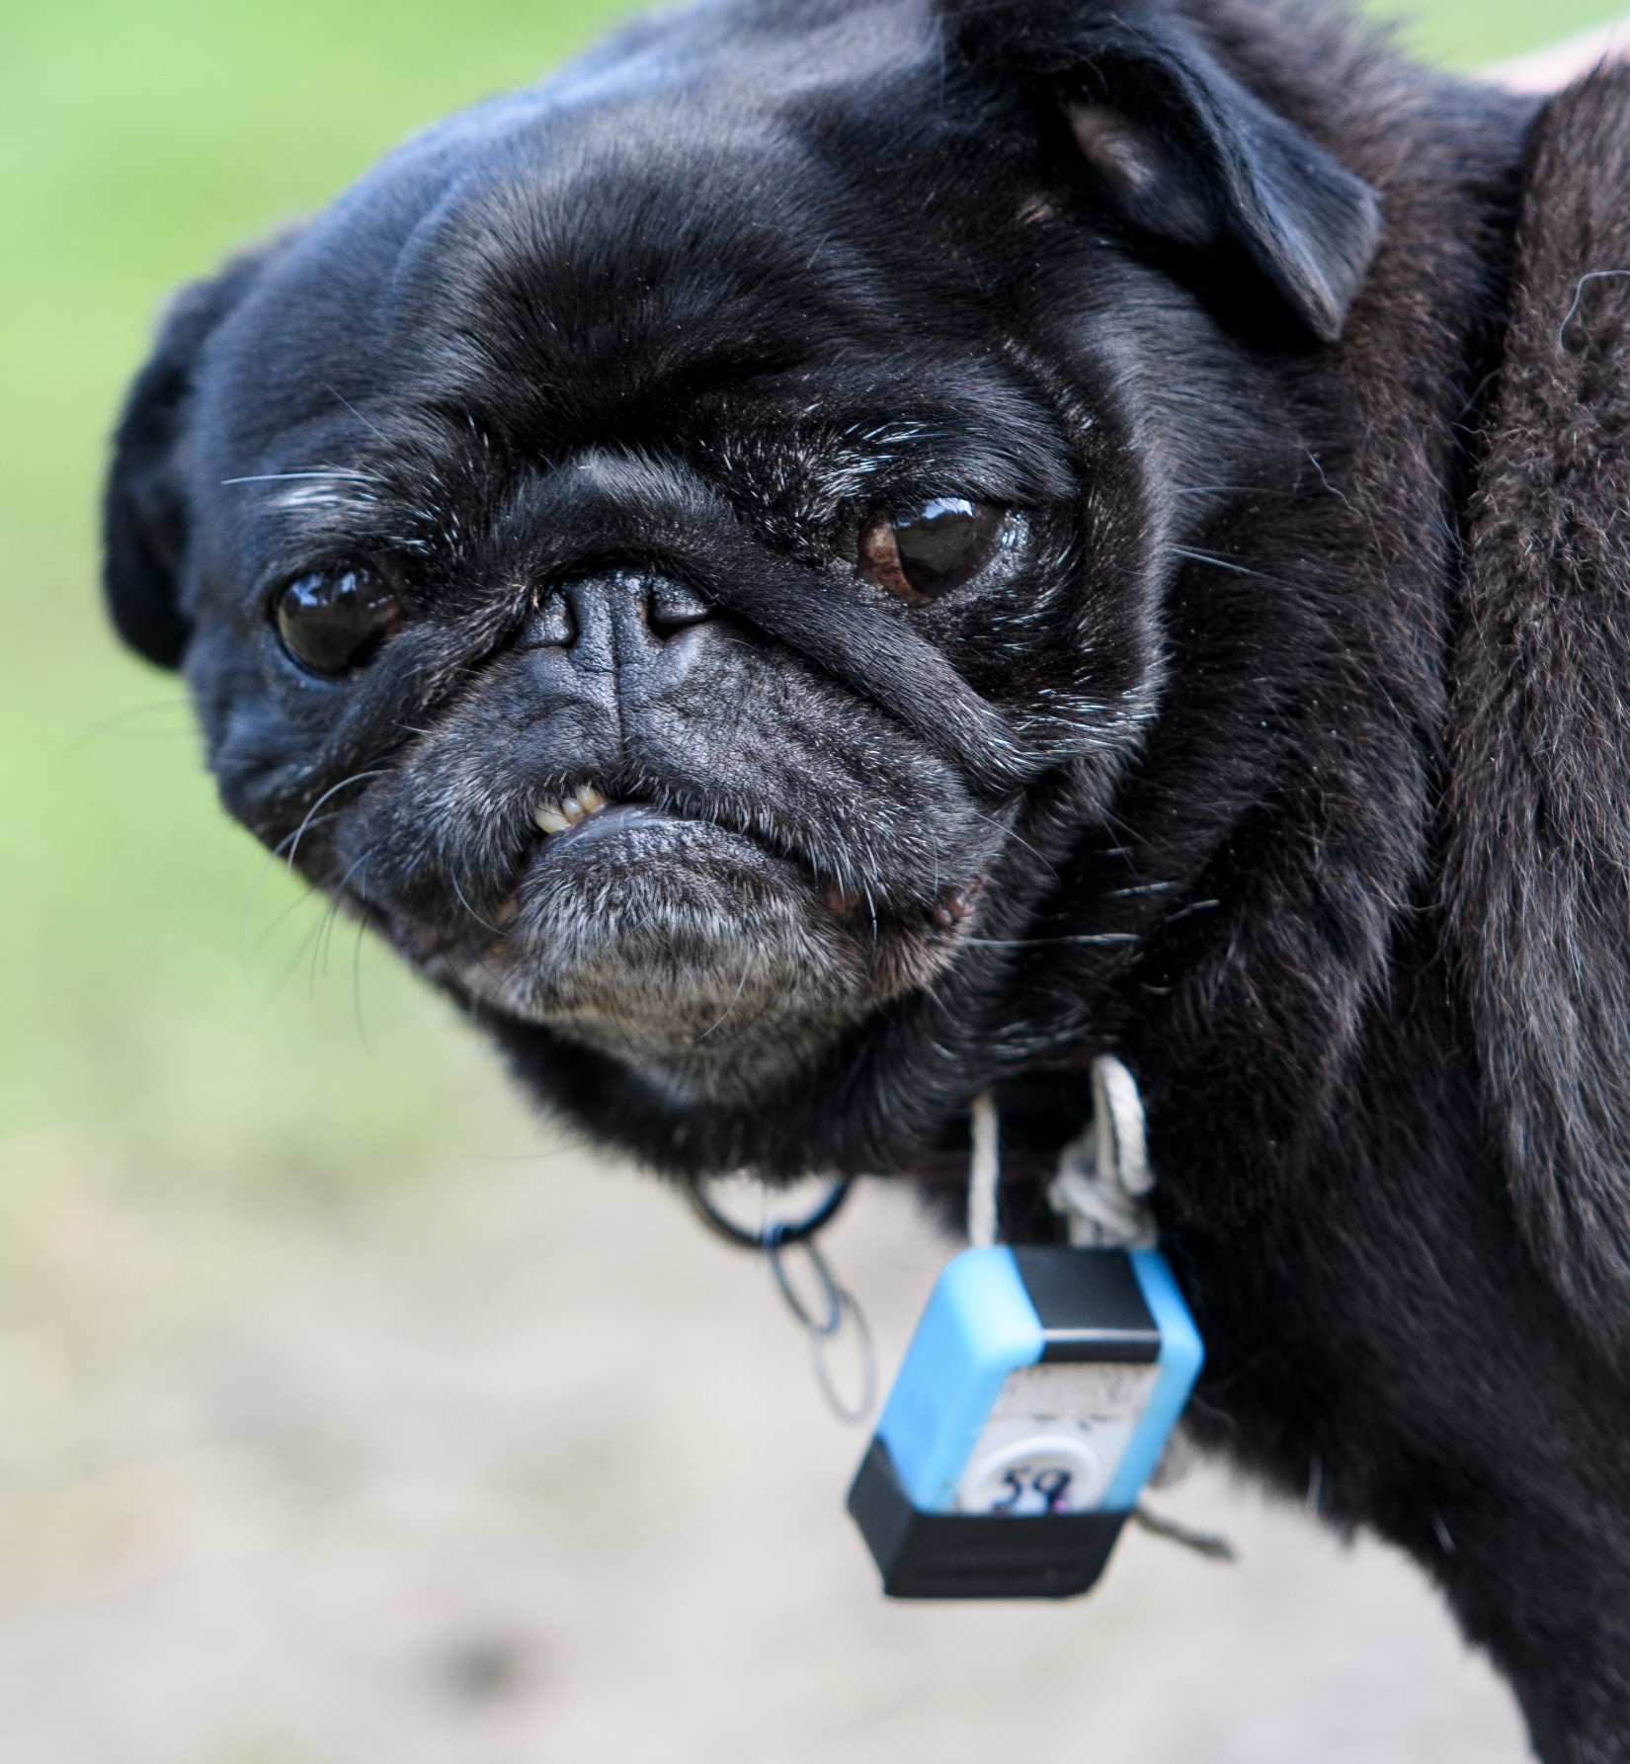
Next steps…
Carrying out further monitoring on dog owner behaviour with the signs (ongoing)
Creating A2 permanent large interpretation signs
Conduct workshop for nationwide practitioners, extending influence beyond initial partners.
We would like to create more impact by:
engaging directly with dog owners
engaging more with a wider group of landowners nationally

