Slide 1






Is loneliness another pandemic? Loneliness in adolescents: building social connections
Zain Khan
Dawn Watling
Professor
Royal Holloway, University of London
Szonya Durant
Professor
Royal Holloway, University of London
Joe Bathelt
Assistant Professor
University of Amsterdam

Slide 2
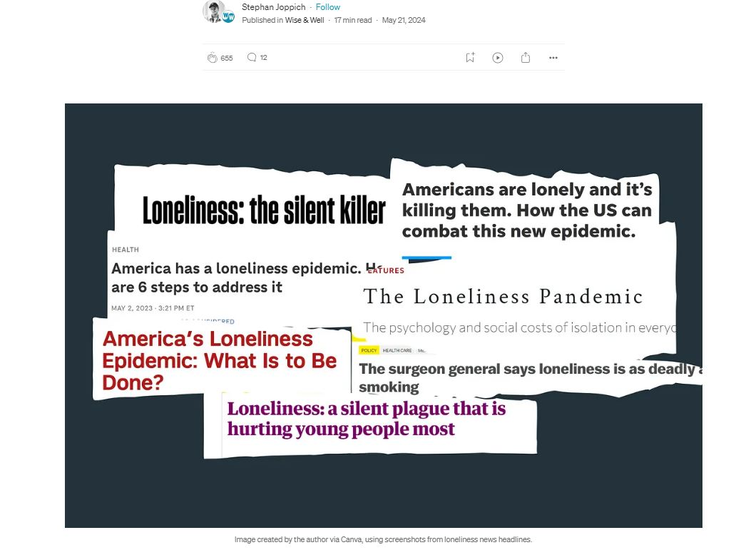

Slide 3
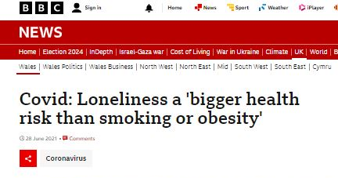
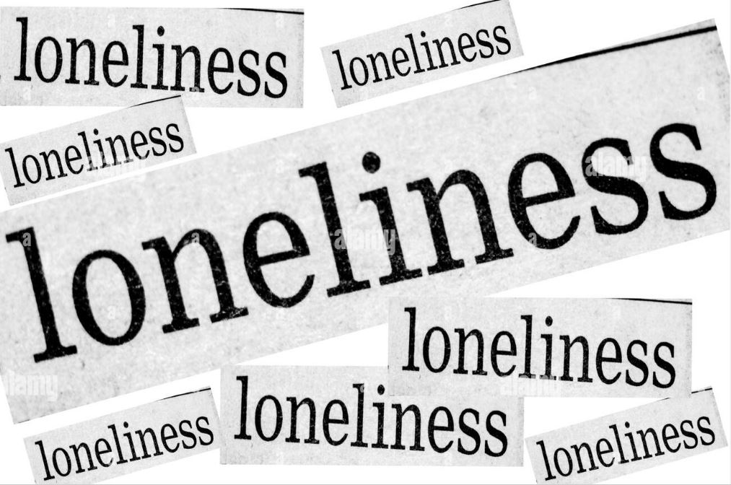
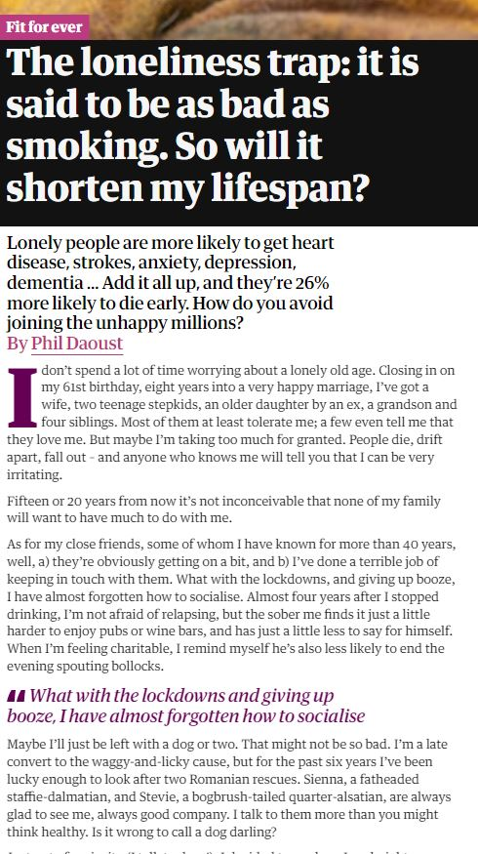
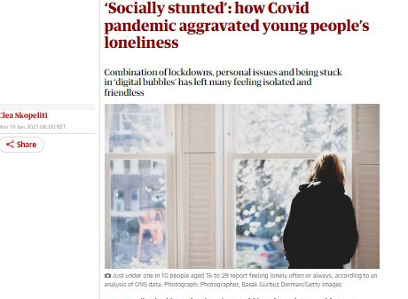
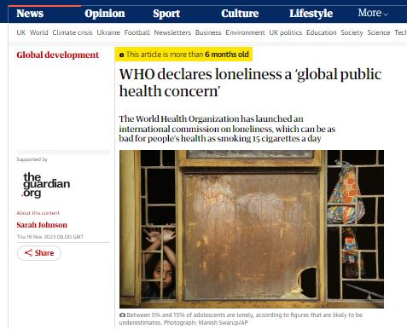
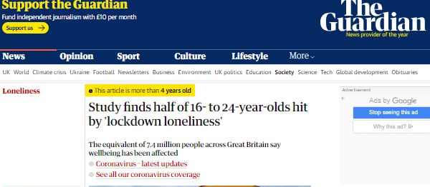

Slide 4
Introduction
We all feel lonely from time to time, here are some examples of such situations:
When we don't have someone to sit down for lunch with
When we move to a new city
When our friends do not have time for us on the weekend
When you get a good news and you have no one to share it with
Over the past few years this occasional feeling has become a constant!
The most connected generation in history is also the loneliest.​

Slide 5
Prevalence in adolescence

Slide 6

Prevalence rate
9.2% – 14.4%
Loneliness
40%
40% adolescents reported feeling lonely often or very often (Qualter et al., 2013)
Prevalence rates of loneliness (12 to 17 years) varied between 9.2% and 14.4% across 76 countries (Surkalim et al., 2022).
Notes:
According to the UK government’s Tackling Loneliness strategy review, reported loneliness is higher for people who:
are 16-24 years old
are female (sex at birth)
Social Transition theories suggests that major social transitions in a person's life are a particularly important source of interpersonal differences in loneliness (Peplau and Perlman, 1982).

Slide 7
What is loneliness?
Notes:
Social connectedness is an overarching concept encompassing both belongingness and loneliness. Belongingness refers to the need to belong, based on experiences of social interactions, while loneliness is a subjective feeling of having less social contact than one wants.

Slide 8
Feeling alone vs being alone
Loneliness is an emotional state, when you feel alone or disconnected from others.
You can be home alone, but you don't experience loneliness. It’s a physical state.
Notes:
Negative emotional experience due to a perceived discrepancy between the desired quantity and quality of one’s social relationships (Perlman and Peplau, 1981)
Lonely and non-lonely respondents report having a similar number of friends (Perlman and Peplau, 1982)
Inverse curvilinear relationship between number of close friends and loneliness, depression, anxiety, and stress (Thompson et al., 2022)
Subjective experience of feeling socially isolated, in contrast to objective nature of being alone i.e., having few friends or infrequent contact (Luhmann & Hawkley, 2016; Peplau & Perlman, 1982)

Slide 9
Why study loneliness?

Slide 10

Chronic loneliness outcomes
Anxiety
Depression
Suicidal Thoughts
Physical Health Problems
(Vanhalst et al., 2013)
(Schinka et al., 2013)
(Qualter et al., 2010; Ladd & Ettekal 2013; Qualter et al., 2013).
Mortality Rate
Increased by 26% (Holt-Lunstad et al., 2015)
(Caspi et al., 2006)
Notes:
Note for presentation: Loneliness had been identified as a significant public health issue, and described as a behavioural epidemic (Jeste et al., 2020) even before the COVID-19 pandemic. This highlight possible maladaptive aspects of loneliness. lonely people may experience and approach social inclusion and exclusion in a biased way, and more specifically, in a way that may prolong their loneliness. However, less is known about the mechanisms that determine the chronicity of loneliness.
Moreover, a meta-analysis by Holt-Lunstad et al. (2015) estimated that loneliness increases the risk of mortality by 26%, highlighting its significance as a public health concern.

Slide 11
Implications of Chronic loneliness
01
02
03
A self-reinforcing and highly detrimental risk factor for maladjustment (e.g., Qualter et al., 2015).
Heightened vigilance in the face of social threat
Leading them to view the social world as a more threatening place (Cacioppo & Hawkley 2009).
Experience more negative affects
When encounter negative social interactions (van Roekel et al., 2013).
Notes:
Social pain
Feelings of loneliness can play an important adaptive role in individuals' social functioning (Maner et al., 2007).
It is an alarm system that makes you stop the behavior that will isolate you
Motivated to deal with socializing situations and focus on restoring relationships.

Slide 12
Where does my research fit in?

Slide 13
Exploring underlying mechanisms that can lead to or maintain chronic loneliness
Emotion Regulation
Individuals who experience persistent loneliness often struggle with effectively managing their emotions related to social interactions and feelings of isolation (Qualter et al., 2015).
A likely mechanism that has been implicated in loneliness and other mental health disorders (Lincoln, Schulze, & Renneberg, 2022, Preece et al., 2021).
Notes:
Emotion regulation is a likely mechanism that has been implicated in loneliness and other mental health disorders (Lincoln, Schulze, & Renneberg, 2022, Preece et al., 2021).
Note for presentation: Understanding the emotion regulation differences can provide valuable insights into the development and maintenance of chronic loneliness.
ER is the process of regulating the occurrence, duration, and intensity of internal emotional states and the physiological processes associated with emotions (Morris et al., 2017), including both intrinsic and extrinsic processes responsible for achieving goals when dealing with emotions (Thompson, 1994).
Cognitive reappraisal (CR) - redefines a potentially emotional situation in a way that alters its emotional impact
(b) Expressive suppression (ES) - suppression of emotional expressive behaviour.
Adaptive versus maladaptive emotion regulation strategies in adolescents’ depression and anxiety symptoms (Schäfer et al., 2017; Compas et al., 2017):
ES to be positively linked with internalizing symptoms
CR to be negatively associated to depression and anxiety symptoms
16–24 year olds might have less experience of regulating intense emotions, or of loneliness in general, due to their age (BBC Loneliness experiment, 2018) BBC Loneliness Experiment, ‘The Anatomy of Loneliness’ (2018).

Slide 14
Goal of the research

Slide 15
Propose strategies to enhance social connectedness
Current research focuses on:
Changing how people think
(b) Social skills and psychoeducation
(c) Socially focused supporters
(d) Creative Expression
Mann F, Bone JK, Lloyd-Evans B, Frerichs J, Pinfold V, Ma R, Wang J, Johnson S. A life less lonely: the state of the art in interventions to reduce loneliness in people with mental health problems. Soc Psychiatry Psychiatr Epidemiol. 2017 Jun;52(6):627-638. doi: 10.1007/s00127-017-1392-y. Epub 2017 May 20. PMID: 28528389; PMCID: PMC5487590.
https://www.artandhealing.org/
Notes:
Mann F, Bone JK, Lloyd-Evans B, Frerichs J, Pinfold V, Ma R, Wang J, Johnson S. A life less lonely: the state of the art in interventions to reduce loneliness in people with mental health problems. Soc Psychiatry Psychiatr Epidemiol. 2017 Jun;52(6):627-638. doi: 10.1007/s00127-017-1392-y. Epub 2017 May 20. PMID: 28528389; PMCID: PMC5487590.

Slide 16
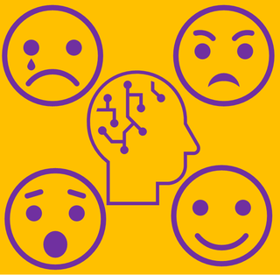
Interested to be involved in research?
1. Social connectedness and mental health (zain.khan.2022@live.rhul.ac.uk)
2. RISE project (Reactions and Interacting on Social mEdia)
(gemma.rides@rhul.ac.uk)

Slide 17

Thank you!
Do you have any questions
zain.khan.2022@live.rhul.ac.uk
@zainkh_psy

