Slide 1





Value Formation in School
What we are researching
What is happening in this project?
From this, we will understand how schools can best support children to develop value-related competences (e.g., to understand their own and others’ values, and to act on their own values).
In this project, we are studying value development in primary school in the UK and in Switzerland, looking at value-related goals in the educational systems in both countries. This knowledge is important to support teachers and schools and to provide evidence for best practice.
For this project, we have been awarded a big grant from the SNSF in collaboration with the ESRC.
We will invite pupils to complete a questionnaire about their values, and we will invite teachers to complete a questionnaire about their own value-related goals and activities in their school.
We aim to do this research between January and April 2022.
What are we offering?
At the end of our project, we are offering feedback on key findings from our project as well as a training for teachers that gives insights into values education in primary school and illustrates ways to promote pupils’ value-related competences.
What knowledge are we generating in this project?
Who can participate in our project?
Our project will generate novel insights into how school education shapes children’s values. There is very little empirical research in this field.
We are inviting primary school teachers who are teaching in Year 2 and Year 3 and their pupils to participate.

Slide 2
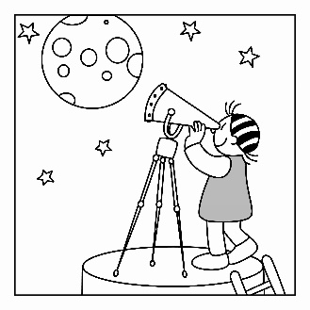
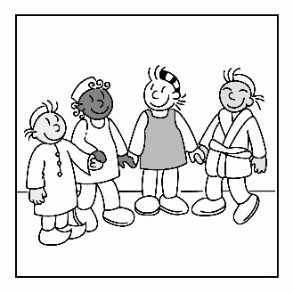
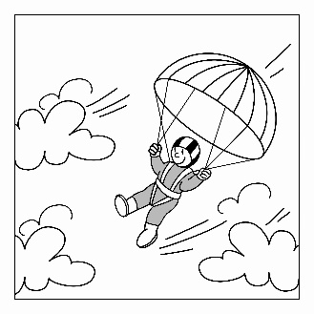
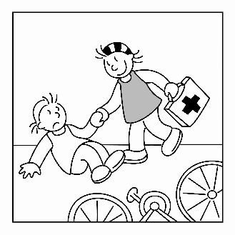
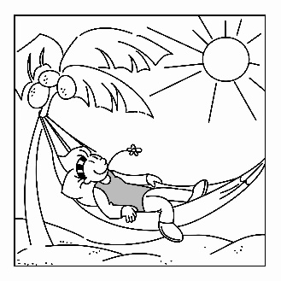
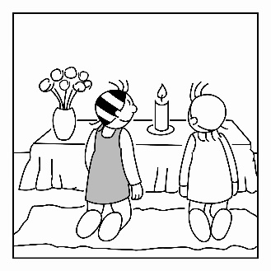
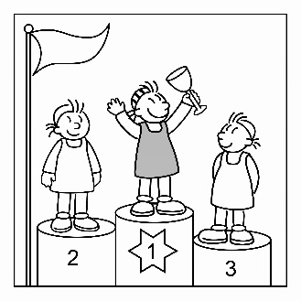
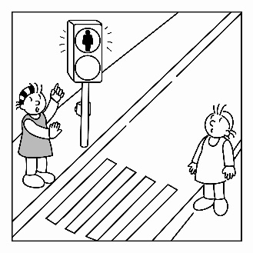

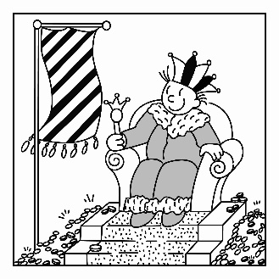
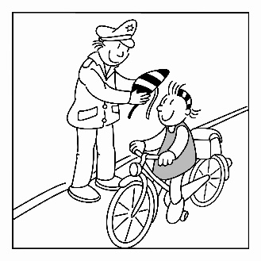
Human Values
What is important to me? How do I want to live? What are my goals?
All these questions tap on values. They are about positive goals and give direction to human life.
In our project team, we have been researching human values for almost two decades. We have run many projects in primary schools, and thousands of children have participated in our research. Please find more information around the project and the project team on our project webpage:
https://bildungswissenschaften.unibas.ch/en/research/value-formation-in-school/
to discover new things
to make new friends
Self-Direction
Universalism
to do exciting things
Benevolence
Stimulation
to help others
Hedonism
Tradition
to enjoy life
to think of God
Achievement
Conformity
Contact:
Dr. Anna Döring, Senior Lecturer in Psychology,
University of Westminster
 a.doering@westminster.ac.uk
 +44 777 6018306
☒https://www.westminster.ac.uk/about-us/our-people/directory/doering-anna
Power
Security
to be the best
to observe the rules
to be rich and powerful
to be safe

