Slide 1
Post 18 Options

Slide 2
Post 18 Options
Work?
Click an option for more information
What’s your next move?
Study?
Combine?

Slide 3
Post 18 Options
Work?
Post 18 options video
Click an option for more information
What’s your next move?
Study?
Combine?

Slide 4
Click the home button to return to the post 18 options
Work
Start a Business
Get a Job
Internship
Think carefully about your ideas and make a solid business plan.
Need a USP (unique selling point)
You may need special skills, qualifications or experience
There may also be start-up costs.
Get straight into the working world to start earning. You'll need an up-to-date CV and cover letter.
Duration: Dependent on job offer
Entry requirements: Requirements differ between employers
A period of work experience where you can try out a job and get to know an industry.
Duration, content & requirements all depend on the company.
Usually anywhere between 1 week – 1 year
Like work experience but normally for longer
Tend to be unpaid but good experience

Slide 5
Scan the QR code for more information or click the home button to return to the post 18 options
Study
University
Study a degree level course
Learn through lectures, seminars, group projects and independent study.
There's funding available to support you and you can study full or part- time.
Location: At a university, college or online. You could go away to study, stay local or go abroad.
Duration: 3 to 4 years
Entry requirements: Universities set their own entry requirements. You'll usually need A Levels or equivalent qualifications

Slide 6
Click the home button to return to the post 18 options
Study
Retakes
If you didn't get the results you wanted, you can resit some of your courses or sign up for some new qualifications.
Takes 1 year in school, sixth form or college
Speak to careers advisor for more info
Also gap year or deferring a year

Slide 7
Scan the QR code for more information or click the home button to return to the post 18 options
Study
Higher Technical Skills Course
Learn the higher level skills that employers want in sectors like
Finance, engineering, management and scientific jobs on a classroom-taught course.
Location: College or university
Duration: 1 to 2 years
Entry requirements: Varies by course
Speak to your local provider (eg college) for more info

Slide 8
Scan the QR code for more information or click the home button to return to the post 18 options
Combine
Traineeship
A course that includes a work placement that will get you ready for an apprenticeship or a job.
You’ll get work experience and some help to apply for your next steps.
You can also improve your maths and English skills.
You’ll spend a minimum of 70 hours in a work placement with the rest of your time in college or a training centre
In a very broad sector like retail, administration or hospitality
Duration: 6 weeks to 1 year
Entry requirements: You need to be aged between 16 to 24
or up to 25 with an Education Health and Care Plan with no higher than a level 3 qualification

Slide 9
Scan the QR code for more information or click the home button to return to the post 18 options
Combine
School Leaver Scheme
A chance to learn and train with a large company while earning a wage.
Offered in sectors like accountancy, engineering, finance, IT, law, leisure and retail.
Similar to graduate employment schemes run over a longer period of time.
You'll often rotate between different locations with the same company to get experience
and it can include distance learning or time in college or university
Duration: 3 to 7 years
Entry requirements: Usually high grade A levels or equivalent and a keen interest in the sector you want to work in
Qualifications: A university degree and/or professional qualification

Slide 10
Scan the QR code for more information or click the home button to return to the post 18 options
Combine
Apprenticeship
80% in workplace – learning skills relevant to that job
Range of levels
Paid an apprentice salary AT LEAST = minimum wage (£4.15 an hour)
You must apply to it like a job
Trains you for that specific job role like chef, gardener or carer
Minimum duration of a year
Lead to:
Work , Next level of apprenticeships ,University or College
Once you’ve decided on that area & completed the apprenticeship, that’s pretty much what you’re confined to

Slide 11
Royal Holloway Post 18 options guide
https://youtu.be/ltjEJo5PKdk
Next steps after this session…

Slide 12
Next steps after this session…
Scan the QR code to find out more about the post 18 options your are interested in
Research 1 post 18 pathway you are interested in studying

Slide 13
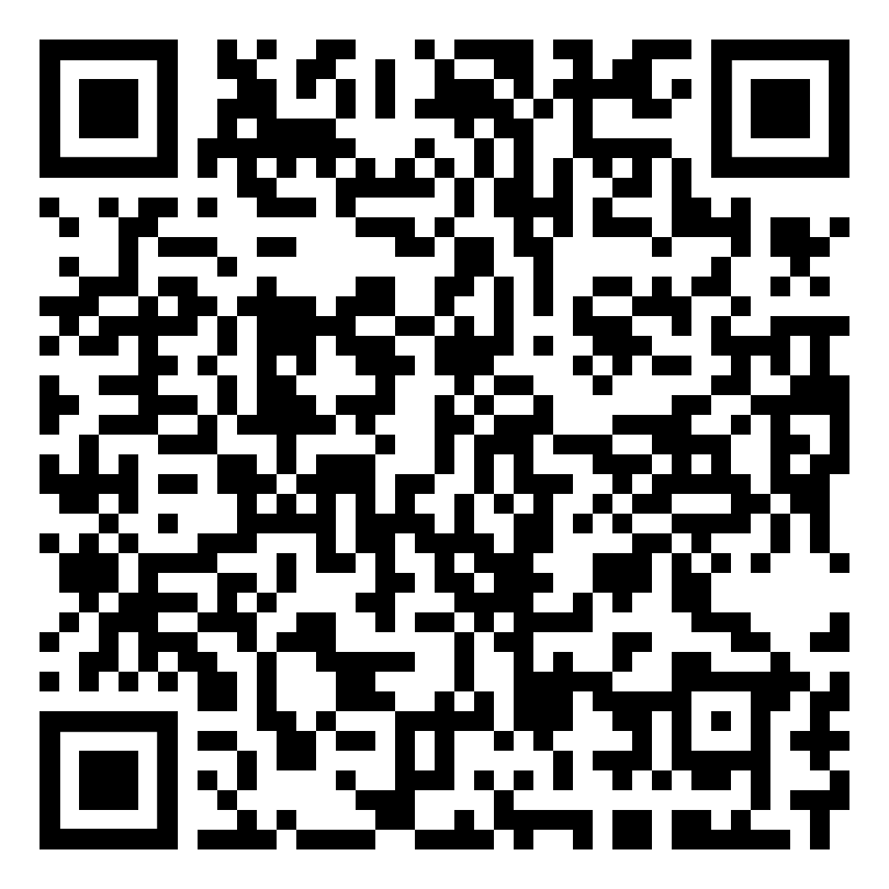
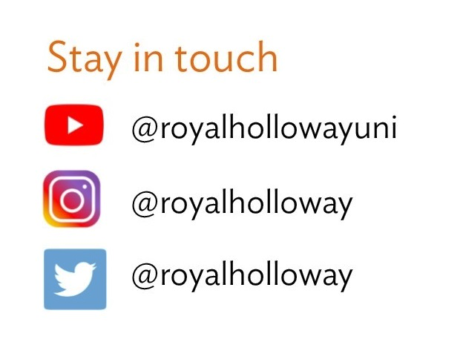
Email us:
wa@rhul.ac.uk
Order a prospectus
Stay in touch
Visit our website:
royalholloway.ac.uk
Questions & get in touch
Notes:
Turn cameras back on for this point (?)
I will leave this up for a while in case you want to take a picture of the details
Before we end, we’ve allowed a bit of time for some questions.
If you have anything at all to ask, please do so in the chat bar
Ill read them out loud
Will fill the time with some information whilst you are typing:
Contact details are on screen for us to stay in touch or find out more info
If you want copy of powerpoint, email schools
Or scan QR code for prospectus
There will be a quick evaluation form as soon as you leave this
Would be really grateful if you could take 30 secs to fill it out
Then read out questions
Back up Q – what did you do for your options?
End with:
Thank you so much for listening and please do get in touch if you have any other questions.
Have a wonderful evening, bye for now.

