Slide 1
How to write a UCAS Teacher Reference
March 2020
Supplied by Royal Holloway, University of London

Slide 2
Contents
What is the UCAS reference?
UCAS Guidelines
What do admissions specialists want to read about?
Reference structures
Tips, tricks and common problems

Slide 3
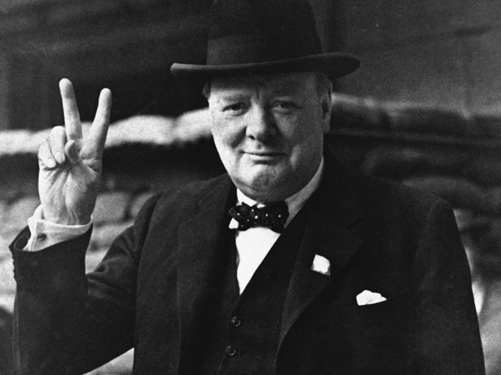
What is a UCAS Teacher Reference
Designed to provide universities and colleges with an informed and positive academic assessment of the suitability of an applicant for further study
“He has no ambition. If he were to exert himself he might yet be first at the end of term.. Is a constant trouble to everybody and is always is some scrape or another…” (Winston Churchill)
“Mentally slow, unsociable and adrift forever in foolish dreams” (Albert Einstein)
“would be a very good pupil if she lived in this world” (Dame Judi Dench)

Slide 4
Guidelines
4,000 characters or 47 lines of text
Some European characters are acceptable, but no bold, italics or underlines
Advice is to write in a word processor first, then copy and paste into UCAS. (Bear in mind that UCAS may use a different margin size to you)
Page will timeout after 35 minutes- make sure you save regularly
Start populating the reference as soon as the student completes their UCAS registration
The reference is not made available to the student, however, a copy can be requested under the Data Protection Act
English must be used, unless the student’s application is in Welsh and is being sent to a Welsh university

Slide 5
The reference process – basic model
Student starts application
Final approval of application & reference
Reference writing & submission by tutor
Approval of application by referee
Final submission of application to UCAS
Subject teachers write subject reports

Slide 6
How to begin
Read through the student’s entire UCAS application, including the personal statement and focus on the following:
Academic performance post 16
Potential for success in Higher Education
The student’s individual skills, qualities and experience, including their attitude, motivation and commitment
Why the student is suited to their chosen subject and career
Relevant achievements and extra curricular activities that relate to studying at university
Personal circumstances / factors that may have affected the student’s performance
The universities chosen by the student and the entry requirements for their chosen course

Slide 7
Why is the reference important?
It assists in the selection/ decision making process
It can be used to distinguish between students with similar profiles
Universities use it to understand the real potential of the applicant and their ability to succeed at university
The reference provides information about factors that might prevent the student from achieving their predicted grades, for example, any personal circumstances, disruption to studies

Slide 8
Who, how and what?
Who reads them?
Departmental admissions specialist
How do they decide?
By comparing to a check list of criteria
What are they used for?
As part of the selection process
For ‘near misses’ at confirmation
Central admissions team
During clearing
Each university has a different policy, but usually:
Academic members of staff
Personal judgement

Slide 9
What are admissions specialists looking for?
Information about the student’s school / college
Academic achievement and potential of student
Academic qualities
Suitability for chosen course
Confirmation of what the student has said in their personal statement
External activities or employment that may be relevant
Personal circumstance where applicable
9

Slide 10
Example structure of the reference
Information on the school/college
Student’s suitability for their chosen course
Subject- by subject report
Special circumstances (if applicable)
Concluding statement

Slide 11
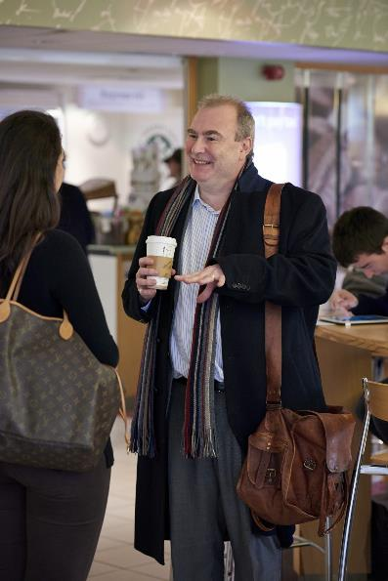
Information on the school/college
This should be a small introductory paragraph including:
Size/number of students in the school overall
Number or proportion of students progressing to HE
Typical number and patterns of qualifications taken by students
Extra courses/ qualifications students take, for example, EPQ
There is no need to include details regarding widening participation as this information is usually collated centrally

Slide 12
Special circumstances
Occasionally a student’s studies are disrupted due to illness or family issues.
With the student’s permission, it is advised that you write briefly about the disruption and how it impacted the student’s studies.

Slide 13
Subject specific information
Subject reports should be written by the subject teachers and compiled by the referee. Subject reports should include:
Academic and practical skills related to the subject
Capability as an independent learner
Examples of student exploring the subject outside of lessons
The student’s ability to work hard and keep to deadlines
Their attainment in comparison to the rest of the group

Slide 14
Compiling subject reports
Extract material that is repeated in several reports and collate, for example, ‘all of the student’s tutors agree…’
Have a clear structure (most relevant subject first, a new paragraph should be allocated to each subject
Make sure the most relevant subject to the student’s chosen course has the most detail
Ensure the student’s name is correct throughout – it can be easy to copy and paste and forget to change the name!

Slide 15
Some examples…..
Academic skills
“X has found the course challenging but is making progress in her A-level studies in Mathematics. She is able to set out calculations in a logical form and can recognise appropriate methods for problems presented in familiar contexts. She can apply relevant theories with some success and written solutions are improving in detail and accuracy.”
Relevant project work
“X’s extended project into gender differences in maths makes great use of psychological theories and shows her willingness to read around the subject in a greater depth than is required at A-level.”

Slide 16
Predicted grades
Requested in a separate box
There is a space for predicted grades/results next to the student’s list of ‘grade pending’
It is difficult to be accurate:
47% are too optimistic, 9% too pessimistic
Be realistic:
Make sure the student has the potential to achieve the grades listed
Be balanced:
explain why predicted grades may not match current attainment
Share:
Inform the student of their predicted grades. They may not agree! It also encourages the student to be aspirational but realistic
Too high:
student may have to find places through clearing
Too low:
student may not be offered a place

Slide 17
Make sure there is enough detail….
“X is motivated towards his studies and shows initiative when working on assignments.. X is an attentive student in class. X is good at data interpretation and developing coherent arguments”
“In Economics, X is a conscientious and highly motivated pupil who is firmly focused on achieving success. He has impressed with his scholarly, enquiring approach and quiet determination and he is excelling in his studies as he reads widely beyond the confines of the syllabus.
In class, he is always attentive and his contributions to discussions are carefully considered, insightful and accurate. He has an excellent grasp of even the most complex issues studied and he can develop effective, coherent arguments supported by carefully selected diagrammatical analysis. He enjoys data interpretation and analysis and he makes full use of all available information when making judgements.”

Slide 18
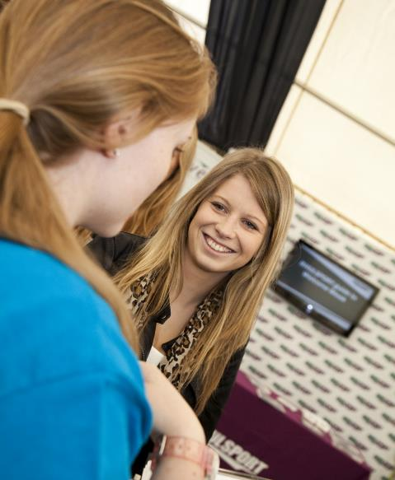
Common issues
A student isn’t doing very well academically
Focus on the student’s personal qualities and extra curricular activities
Highlight effort and any improvements that have been made
You don’t know the student very well
Meet with the student beforehand
Talk to colleagues who know the student better
Unfamiliarity with the student’s chosen subject
Talk to the student and colleagues who are more familiar with the subject
Do some background research

Slide 19
What if the reference is for an ex-student?
There are two options:
Add the student to the current cohort in Apply, and treat the application in the same way as current students by having control of the application. Access will be given to the whole application, reference needs to added, the application approved and submitted to UCAS
OR
Add a reference only and the student retains control. Access to the whole application is denied. The student submits the application to UCAS

Slide 20
Concluding remarks
A reference needs to be specific and show you know the student
Write clearly and concisely – admissions specialists are experts at speed reading so the clearer the better
Keep the paragraph about the school short – tutors want to know about the student
Don’t mention one specific institution
Universities expect honesty

Slide 21
We hope the presentation is useful. Please email any questions to schools@royalholloway.ac.uk
Thank you!

